Slide 1
Modeling, Analysis, and Control of Interdependent Networks
Jianan Zhang

Slide 2
Outline
Introduction
Theory: modeling interdependent networks
Random geometric graph
Percolation analysis
Random and geographical failures
General layered graph
Network connectivity under failures
Robust routing under failures
Applications of interdependent networks
Interdependent power grid and communication network
Distributed computing networks
Future work

Slide 3
Interdependent networks
Two Networks A & B are interdependent if the operation of Network A depends on operation of Network B and vice versa
Communication Network
Monitoring & Control of Pipelines
Gas Network
Monitoring & Control of substations
Electricity for Pumping Gas in Compressor Stations
Electricity for Routers
Fuel for Gas Turbines
Power Grid
Monitoring & Control of Railroads
Transporting Coal for Turbines using Railroads
Electricity for Railroads
Electrical Vehicles
Transportation
How to model interdependence and the impact of failures?

Slide 4
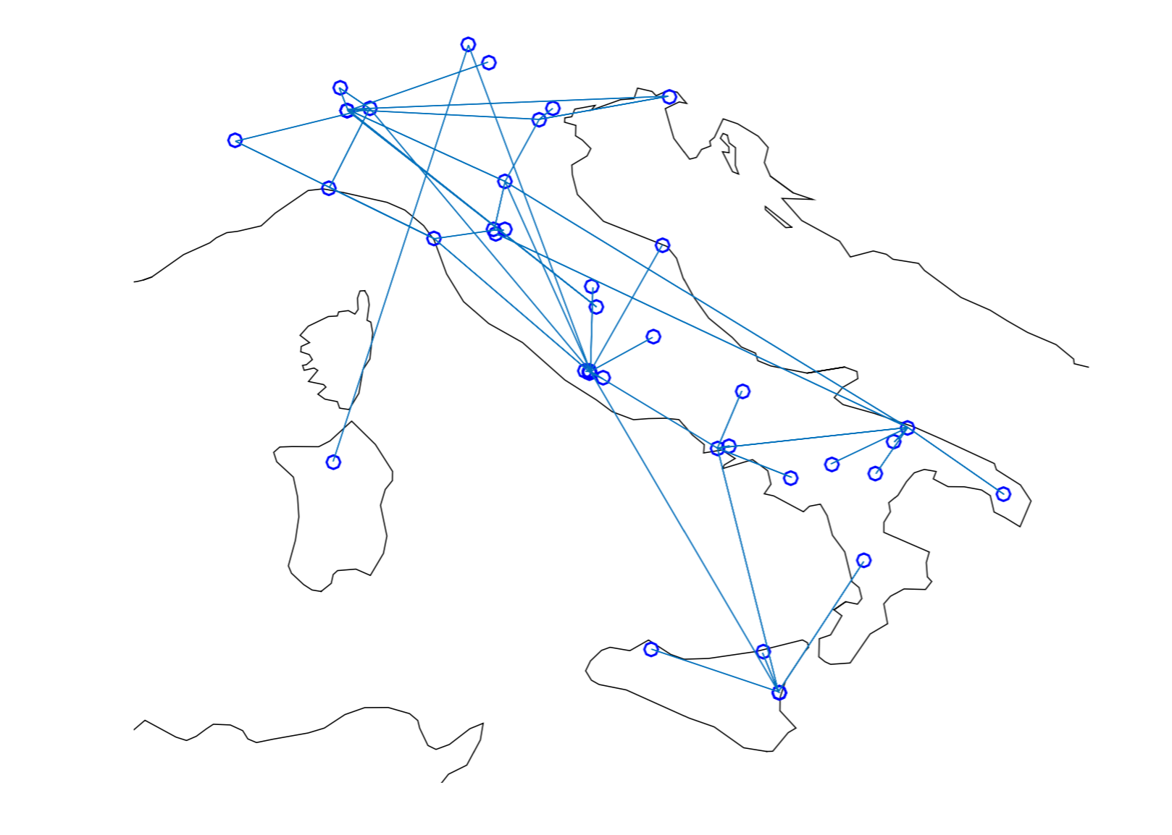
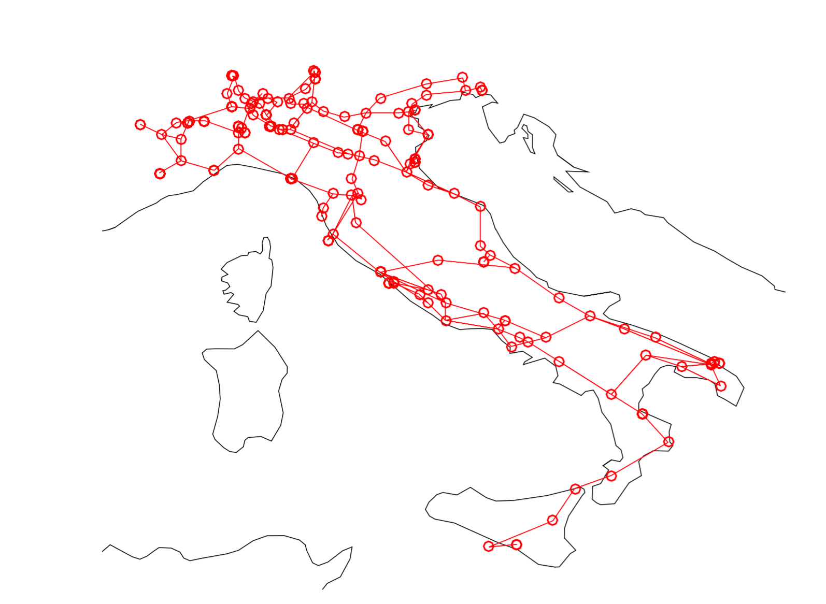
Example of power and communication
Dependency in Italian power grid and communication networks
Power grid: electricity for network routers
Communication networks: control of power substations
A large cascading breakdown may occur from small node failures
A country-wide blackout in Italy, 2003 [1]
Initial node failure
Cascading failure
Cascading failure
(Communication networks)
(Power grid)
[1] S. V. Buldyrev, et al., “Catastrophic cascade of failures in interdependent networks,” Nature 2010.

Slide 5
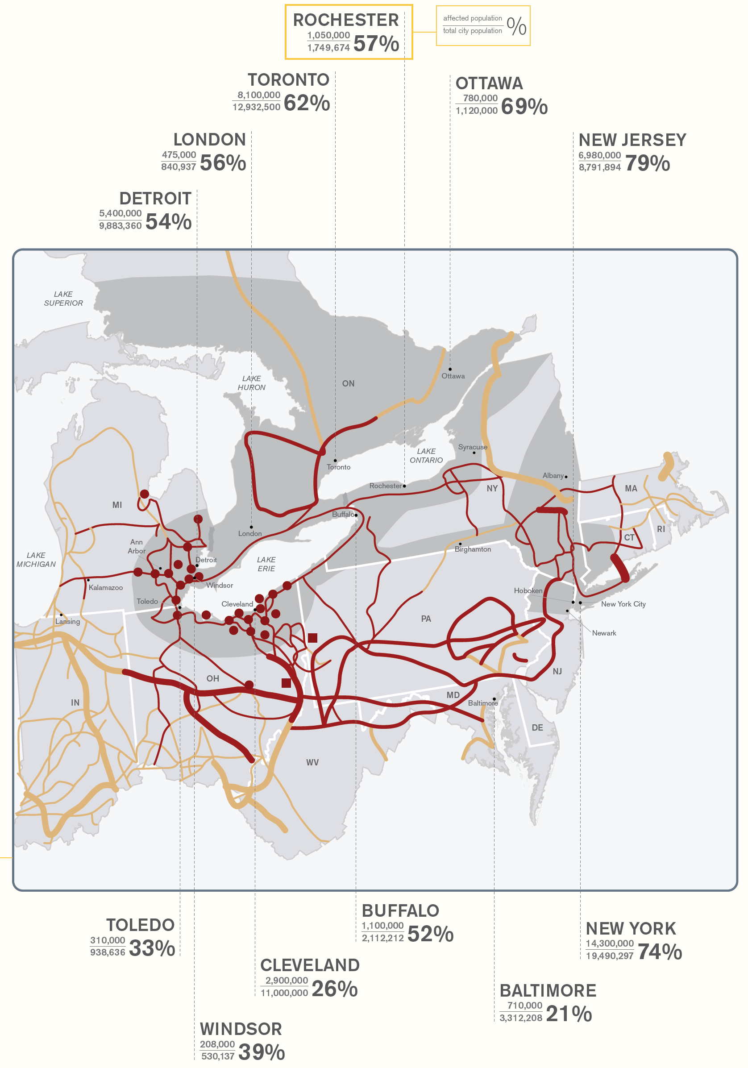
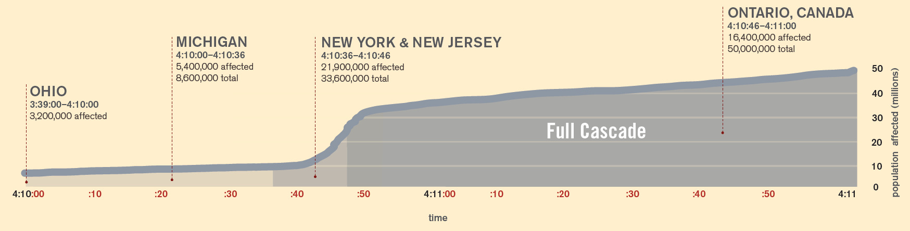
Cascades cause large scale failures
2003 Northeast Blackout (Aug 14)
Initial power failure at 1:31pm
Cascading failure impacts entire Northeast America from 4:11pm and lasts 2 days (50M people affected)
Impacts on interdependent systems: communication, water supply, transportation, …
[Source: http://www.robynboehler.com/Blackout-2003]

Slide 6






Examples of interdependent networks failures

Slide 7
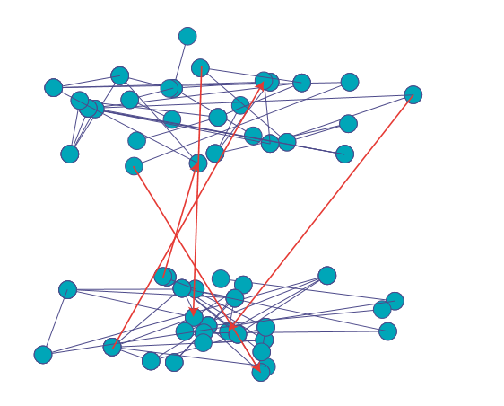
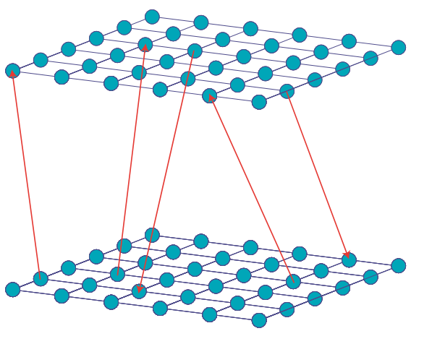
Related work
Interdependent random graph models (node-to-node)
Each network is modeled as a random graph [Buldyrev, et al. 2010]
Every node in one graph is interdependent with a node in another graph
Mutual giant component
Cascading failures due to interdependence
Extensions: lattice models [Bashan, et al. 2013]
From: Bashan, et al. 2013

Slide 8
Outline
Introduction
Theory: modeling interdependent networks
Random geometric graph
Percolation analysis
Random and geographical failures
Arbitrary graph
Network connectivity under failures
Robust routing under failures
Applications of interdependent networks
Interdependent power grid and communication network
Distributed cloud network
Future work

Slide 9
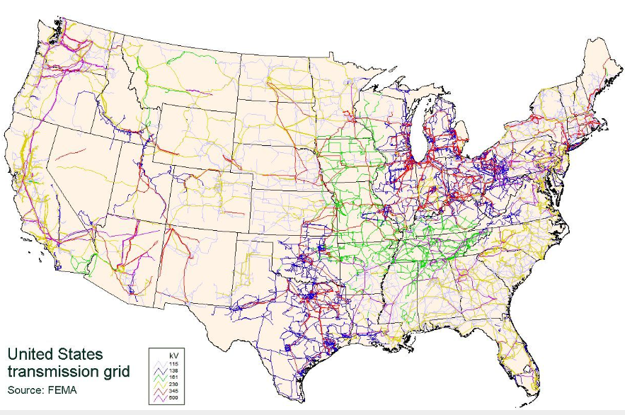
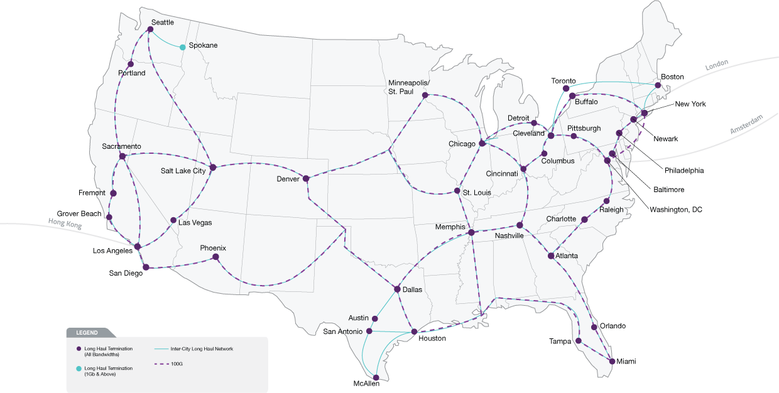
Properties of physical networks
Different network scales:
Two networks may have different node densities and average link lengths.
Geographical locations and proximity:
Connection: nodes within a smaller distance are more likely to be connected.
Interdependence: nodes receive power or control from nearby nodes.
One-to-multiple interdependence:
A node may be supported by multiple nodes (from the other network), with improved reliability.
power grid
communication network

Slide 10
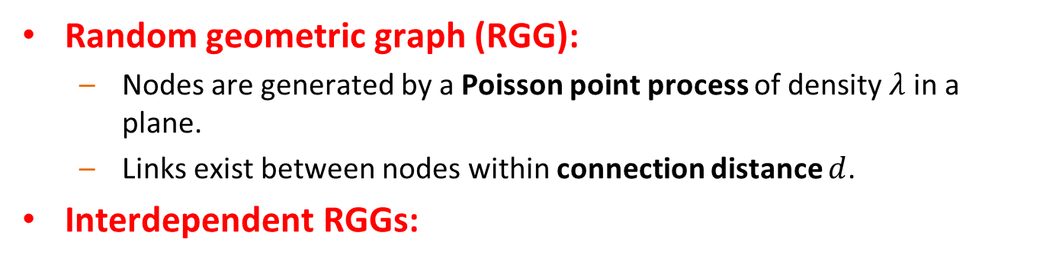
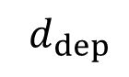
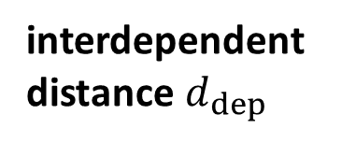
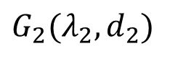
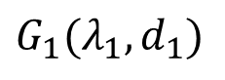
Model
Random geometric graph (RGG):
Nodes are generated by a Poisson point process of density $λ$ in a plane.
Links exist between nodes within connection distance $d$.
Interdependent RGGs:
top view
$$G_{1}(λ_{1},d_{1})$$
$${ d}_{dep}$$
$$G_{2}(λ_{2},d_{2})$$
interdependent distance${ d}_{dep}$

Slide 11
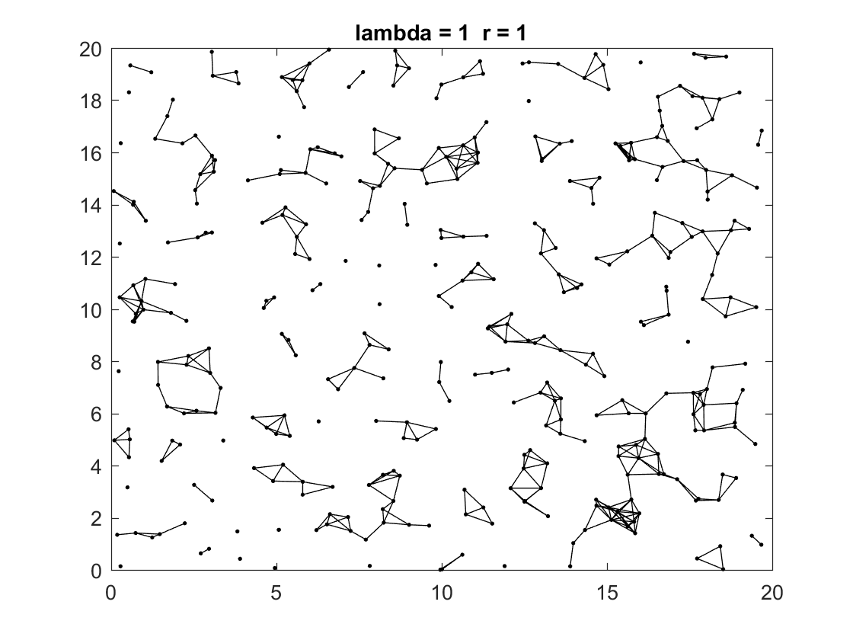
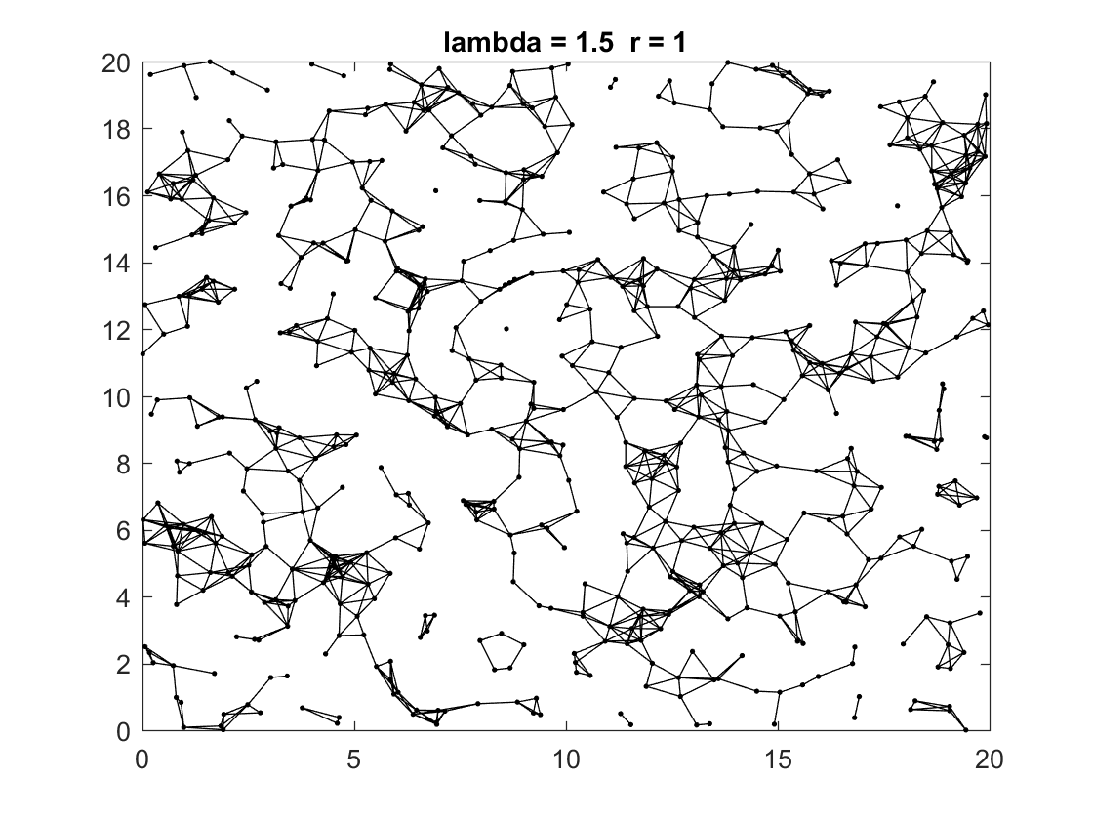
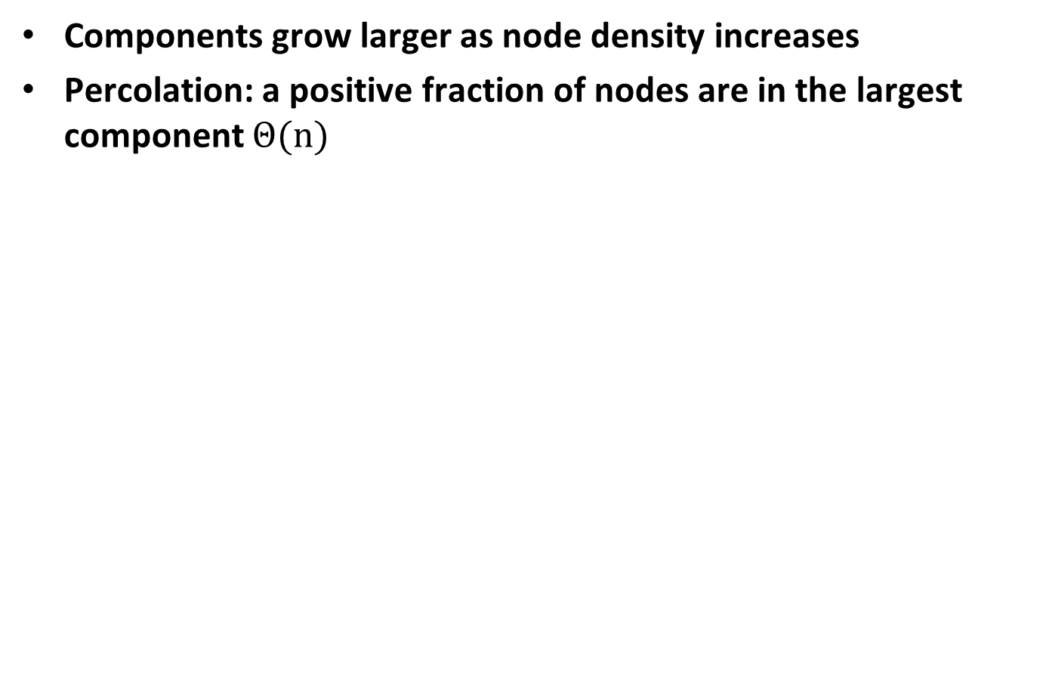
Percolation of RGG
Components grow larger as node density increases
Percolation: a positive fraction of nodes are in the largest component $Θ(n)$

Slide 12
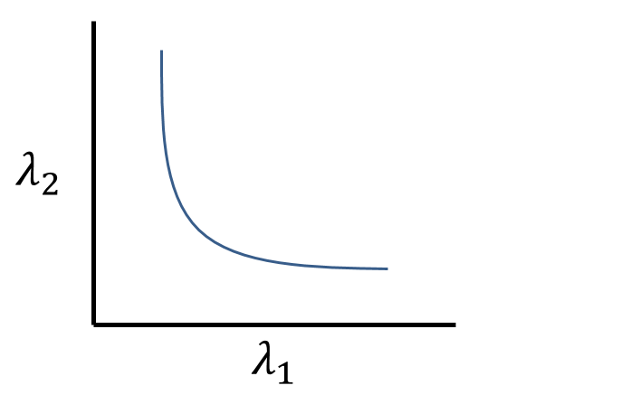
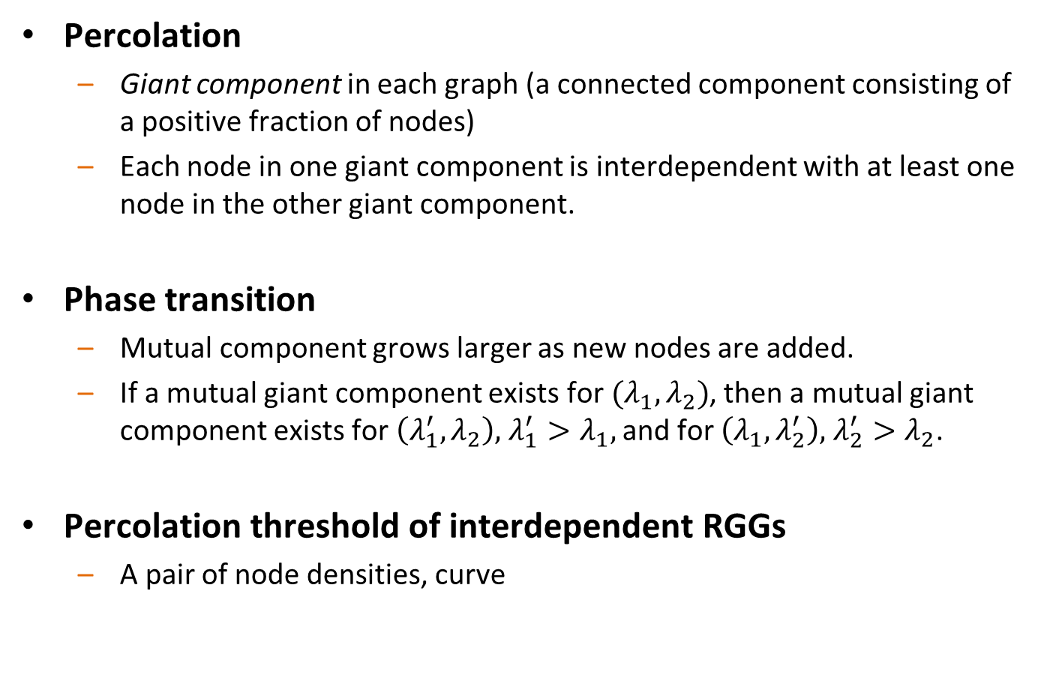
Percolation of interdependent RGGs
Percolation
Giant component in each graph (a connected component consisting of a positive fraction of nodes)
Each node in one giant component is interdependent with at least one node in the other giant component.
Phase transition
Mutual component grows larger as new nodes are added.
If a mutual giant component exists for $(λ_{1},λ_{2})$, then a mutual giant component exists for $\left(λ_{1}^{′},λ_{2}\right),$ ${λ_{1}^{′}>λ}_{1},$ and for $\left(λ_{1},λ_{2}^{′}\right),$ ${λ_{2}^{′}>λ}_{2}$.
Percolation threshold of interdependent RGGs
A pair of node densities, curve

Slide 13
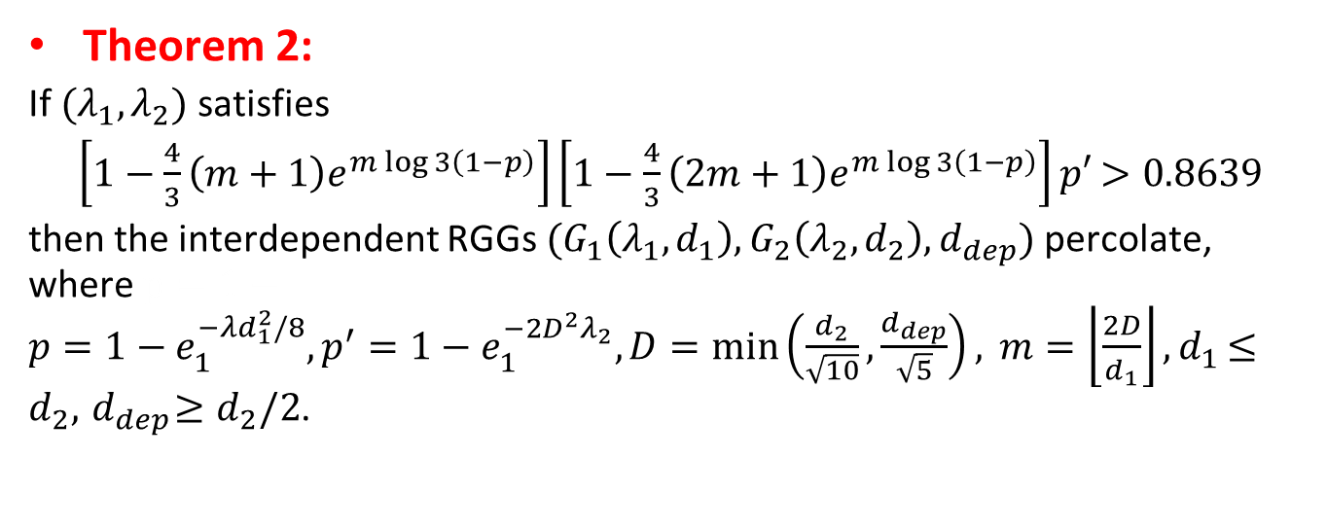
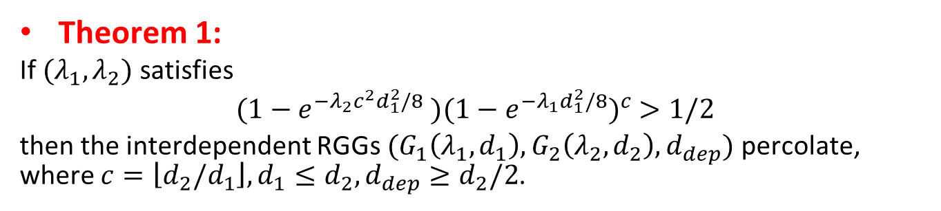
Analytical bounds on percolation thresholds
Map to independent bond percolation on a square lattice
Theorem 1:
If $(λ_{1},λ_{2})$ satisfies
$(1−e^{−λ_{2}c^{2}d_{1}^{2}/8}$ $)(1−e^{−λ_{1}d_{1}^{2}/8})^{c}$ $>1/2$
then the interdependent RGGs $(G_{1}\left(λ_{1},d_{1}\right), G_{2}\left(λ_{2},d_{2}\right), d_{dep})$ percolate, where $c=\left\lfloor d_{2}/d_{1}\right\rfloor , d_{1}≤d_{2}, d_{dep}≥d_{2}/2$.
Theorem 2:
If $(λ_{1},λ_{2})$ satisfies
$\left[1−\frac{4}{3}\left(m+1\right)e^{m\log{3\left(1−p\right)}}\right]\left[1−\frac{4}{3}\left(2m+1\right)e^{m\log{3\left(1−p\right)}}\right]p′$ $>0.8639$
then the interdependent RGGs $(G_{1}\left(λ_{1},d_{1}\right), G_{2}\left(λ_{2},d_{2}\right), d_{dep})$percolate, where $p=1−{p=1−e}_{1}^{−λd_{1}^{2}/8}{, p^{′}=1−e_{1}^{−2D^{2}λ_{2}}, D=\min\left(\frac{d_{2}}{\sqrt{10}},\frac{d_{dep}}{\sqrt{5}}\right), m=\left\lfloor \frac{2D}{d_{1}}\right\rfloor , d}_{1}≤d_{2}, { d}_{dep}≥d_{2}/2$.

Slide 14
99% confidence intervals for percolation thresholds
Study the robustness under random node failures using the curve

Slide 15
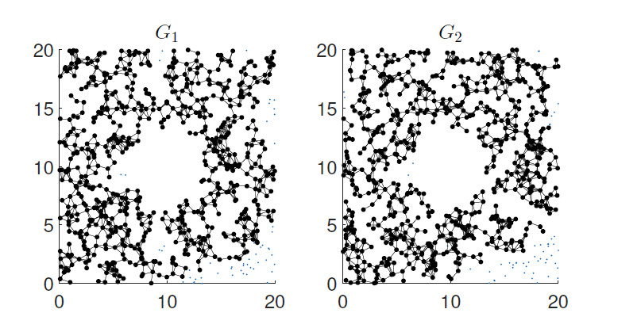
Robust under geographical attacks
If the node densities are above the upper bounds on the percolation threshold, then the interdependent RGGs still percolate after removing nodes in a geographical region.
We derived upper bounds on the percolation thresholds of interdependent RGGs by mapping to a lattice
Changing the bonds/sites from open to closed in a finite area does not affect its percolation [Bollobas & Riodan, 2006]

Slide 16
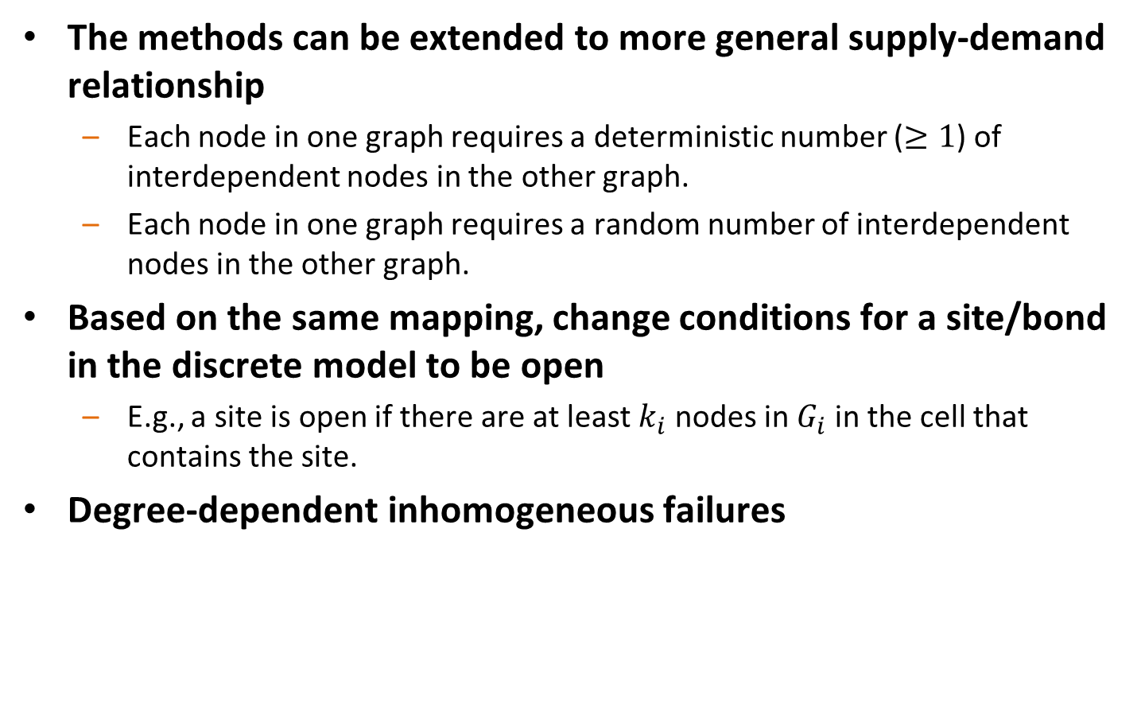
More general supply-demand relationship
The methods can be extended to more general supply-demand relationship
Each node in one graph requires a deterministic number ($≥1$) of interdependent nodes in the other graph.
Each node in one graph requires a random number of interdependent nodes in the other graph.
Based on the same mapping, change conditions for a site/bond in the discrete model to be open
E.g., a site is open if there are at least $k_{i}$ nodes in $G_{i}$in the cell that contains the site.
Degree-dependent inhomogeneous failures

Slide 17
Summary
Summary
An interdependent random geometric graph model for interdependent networks
Percolation thresholds curve
Extensions to general supply-demand relationship
Robust under geographical failures
Degree-dependent inhomogenous failures

Slide 18
Outline
Introduction
Theory: modeling interdependent networks
Random geometric graph
Percolation analysis
Random and geographical failures
Arbitrary graph
Network connectivity under failures
Robust routing under failures
Applications of interdependent networks
Interdependent power grid and communication network
Distributed cloud network
Future work

Slide 19
Key challenges
1. Analysis: How many nodes need to be removed in one network to disconnect the other network?
2. Design: How to design the interdependence to maximize the number of node failures that a network can tolerate?
Focus: On arbitrary finite-size graphs
G₁
demand network
b
d
Removing supply nodes 1 and 2 leads to the failure of demand node b, and disconnects the graph G₁.
a
c
G₂
supply network
2
1
3
4
To answer these questions, we study a model where nodes in a demand network (G₁) depend on nodes in a supply network (G₂).
Notes:
Consider two interdependent networks, where nodes in one network provide supply to the other network. After removing nodes in one network, some nodes in the other network may lose its supply nodes and fail, and the other network may become disconnected.
To study the impact of node failures in one network on the other network, we focus on “network connectivity” as a metric for network functionality. Given two interdependent networks, we study the minimum number of node removals in one network to disconnect the other network.
Moreover, we study the network design problem to assign the interdependence between two networks, to maximize the number of node failures that both networks can resist.
To simplify the presentation, we consider a demand network and a supply network, and study the impact of node removals in the supply network on the demand network.

Slide 20
Model for interdependent networks
A demand node has one or more supply nodes, and it fails if all of its supply nodes fail.
Supply node connectivity (of G₁): the minimum number of node removals in G₂ to disconnect G₁.
G₁
demand network
b
d
a
c
G₂
supply network
2
1
3
4
Notes:
A demand node fails if it loses all of its supply nodes. For example, in the figure, removing supply nodes 1 and 2 leads to the failure of demand node 3.
We define supply node connectivity as the minimum number of supply node removals that disconnect the demand network. This generalizes the concept of “node connectivity” of a single graph. Supply node connectivity indicates the resilience of a network to supply node failures. A robust demand network should have a large supply node connectivity.

Slide 21
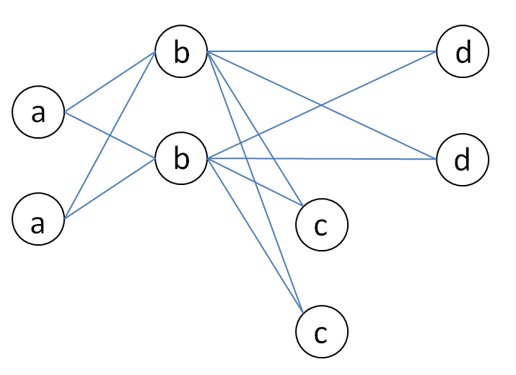
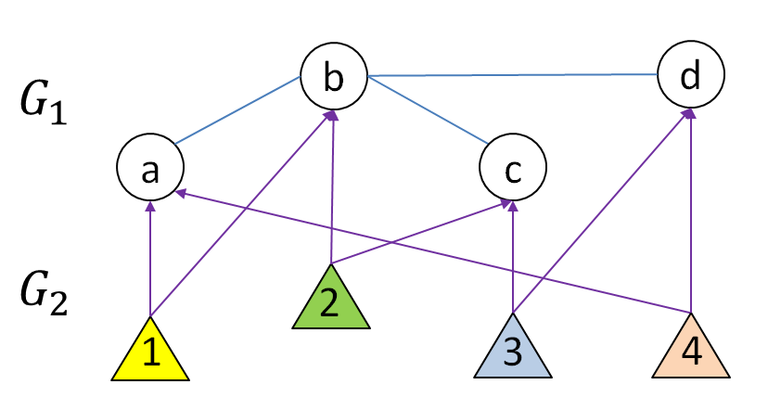
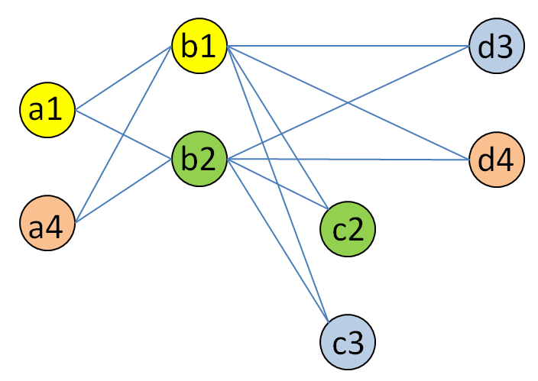
Computing the supply node connectivity
Transformation to a colored graph (right)
The supply node connectivity equals the minimum color node cut in the transformed graph
A color node cut is a set of colors that disconnects the graph
Objective (Q1): Computing the supply node connectivity (NP-hard)
Formulate a mixed integer linear program (exact solution)
Developed a provable efficient polynomial time approximation algorithm
Complexity: O(|V|^{2.5}|E|)
Approximation ratio: q (maximum number of components in an induced graph from a single color)
Notes:
The demand network can be transformed to a colored graph, where a node has k copies if it has k supply nodes, and each copy has a color which corresponds to the supply node. The supply node connectivity equals the minimum color node cut in the transformed graph.
Given a colored graph G with colored nodes and regular edges, a color node cut is a set of colors Cc such that the nodes with colors in Cc are a superset of a node cut of G. A minimum color node cut of G is a color node cut Cc min that has the minimum number of colors. The number of colors in Cc min is the value of the minimum color node cut.
Computing the supply node connectivity of a network is NP-hard. The problem can be reduced from the vertex cover problem. Computing the supply node connectivity of a pre-specified pair of nodes (a source-destination pair) is also NP-hard, which can be reduced from the hitting set problem.
We developed a mixed integer linear program (MILP) to compute the supply node connectivity of a network. The MILP formulation relies on the node potentials. Each node has a potential. Connected nodes have the same potential. If nodes in the same graph have different potentials, then the graph is disconnected. These conditions can be formulated as integer constraints.
We also developed a polynomial time approximation algorithm to evaluate the supply node connectivity, by contracting the connected nodes that have the same supply node to a single component and evaluate the (standard) node connectivity in the contracted graph.

Slide 22
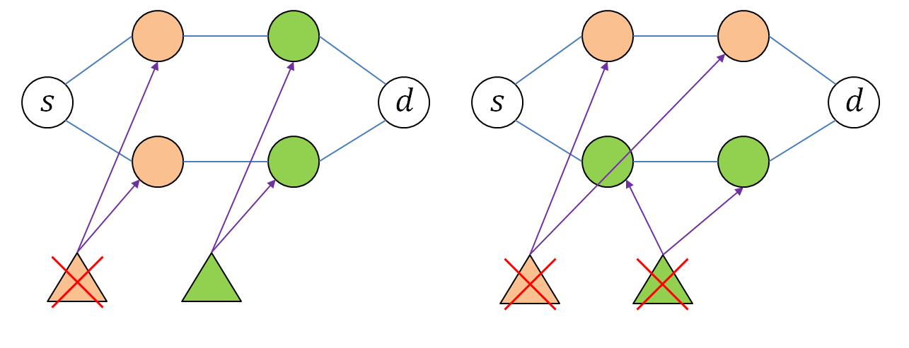
Assignment to maximize supply node connectivity
Designing robust interdependent networks:
Given a demand network and a supply network, assign a fixed number of supply nodes to each demand node, to maximize the supply node connectivity of the demand networks (or an SD pair)
Example:
The supply node connectivity of the SD pair is 1 in the left figure
The supply node connectivity of the SD pair is 2 in the right figure
Notes:
We now consider the network design problem to assign the interdependence between two networks, to maximize the number of node failures that both networks can resist. The objective is to design robust interdependent networks that can resist a large number of supply node failures.

Slide 23
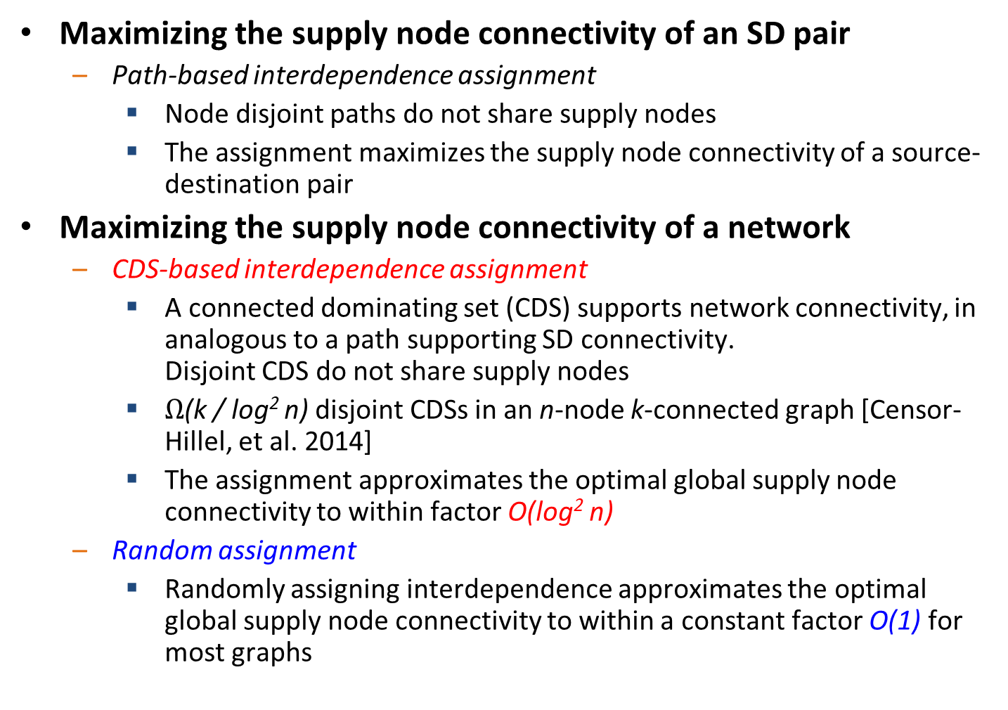
Algorithms for Max. supply node connectivity
Maximizing the supply node connectivity of an SD pair
Path-based interdependence assignment
Node disjoint paths do not share supply nodes
The assignment maximizes the supply node connectivity of a source-destination pair
Maximizing the supply node connectivity of a network
CDS-based interdependence assignment
A connected dominating set (CDS) supports network connectivity, in analogous to a path supporting SD connectivity. Disjoint CDS do not share supply nodes
$Ω$(k / log² n) disjoint CDSs in an n-node k-connected graph [Censor-Hillel, et al. 2014]
The assignment approximates the optimal global supply node connectivity to within factor O(log² n)
Random assignment
Randomly assigning interdependence approximates the optimal global supply node connectivity to within a constant factor O(1) for most graphs
Notes:
We develop interdependence assignment algorithms to maximize the supply node connectivity. All these algorithms run in polynomial time.
To maximize the supply node connectivity of a source-destination pair, we develop a path-based interdependence assignment algorithm. Nodes in a path can have the same supply nodes, while node disjoint paths do not share any supply node. The assignment maximizes the supply node connectivity of a source-destination pair.
To maximize the supply node connectivity of a network, we develop a CDS-based interdependence assignment algorithm and a random assignment algorithm. CDS (connected dominating set)-based algorithm approximates the optimal global supply node connectivity to within factor O(log² n). Randomly assignment approximates the optimal global supply node connectivity to within a constant factor for most graphs.

Slide 24
Maximizing the supply node connectivity
Numerical results in Erdos-Renyi graphs
The assignment algorithms achieve near-optimal supply node connectivity
The assignment algorithms run fast (in near-linear time)
For CDS-based assignment: O(m × polylog(m)), where m is the # of edges
For random assignment: O(n), where n is the # of nodes
Number of Nodes (|V|) | Average Degree (2|E|/|V|) | Number of supply nodes per demand node | Optimal supply node connectivity | Connectivity achieved by CDS-based assignment | Connectivity achieved by Random assignment
25 | 5 | 4 | 6.8 | 6.6 | 6.5
25 | 10 | 4 | 20 | 18.6 | 17.8
50 | 10 | 2 | 7 | 6.8 | 6.2
Notes:
We provide numerical results of the interdependence assignment algorithms. We tested the algorithms in randomly generated Erdos Renyi graphs. For each row, the results are averaged over 10 realizations of random Erdos Renyi graphs with given number of nodes and average degree.
The assignment algorithms almost achieves the optimal supply node connectivity.
The CDS-based assignment algorithm has run time O(m polylog m), where m is the number of edges. The random assignment algorithm run in linear time.
Future plans:
Connectivity augmentation
More supply nodes for critical demand nodes
Improve network reliability with limited supply budget

Slide 25
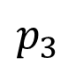
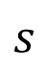
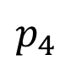
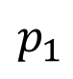
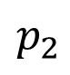
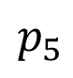
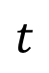
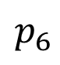
Robust routing in interdependent networks
1: Evaluate the path reliability in the demand network
2: Find the most reliable path between a pair of nodes
A
B
G₁
$$s$$
C
$$t$$
demand network
D
G₂
$$p_{1}$$
$$p_{2}$$
$$p_{3}$$
$$p_{4}$$
$$p_{5}$$
$$p_{6}$$
supply network
Notes:
Consider two interdependent networks, where nodes in one network provide supply to the other network. After removing nodes in one network, some nodes in the other network may lose its supply nodes and fail, and the other network may become disconnected.
To study the impact of node failures in one network on the other network, we focus on “network connectivity” as a metric for network functionality. Given two interdependent networks, we study the minimum number of node removals in one network to disconnect the other network.
Moreover, we study the network design problem to assign the interdependence between two networks, to maximize the number of node failures that both networks can resist.
To simplify the presentation, we consider a demand network and a supply network, and study the impact of node removals in the supply network on the demand network.

Slide 26
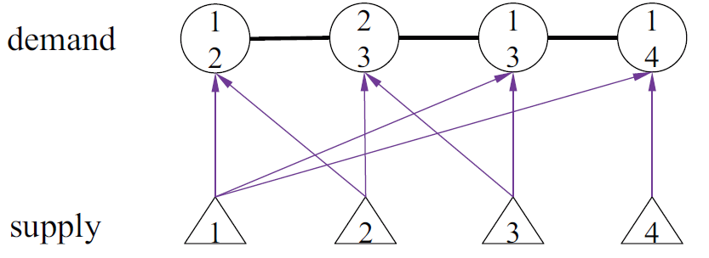
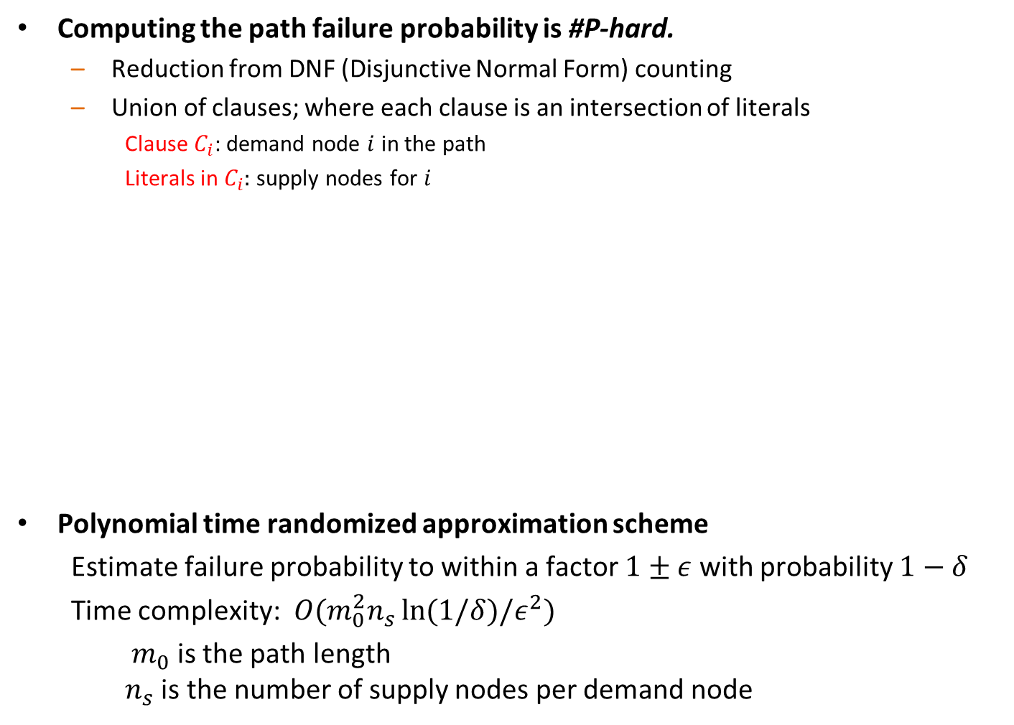
Evaluation of path failure probability
Computing the path failure probability is #P-hard.
Reduction from DNF (Disjunctive Normal Form) counting
Union of clauses; where each clause is an intersection of literals
Clause $C_{i}$: demand node $i$ in the path
Literals in $C_{i}:$ supply nodes for $i$
Polynomial time randomized approximation scheme
Estimate failure probability to within a factor $1±ε$ with probability $1−δ$
Time complexity: $O(m_{0}^{2}n_{s}\ln{(1/δ)/ε^{2}})$
$m_{0}$ is the path length $n_{s}$ is the number of supply nodes per demand node
Failure event = ${(x}_{1}∩x_{2})∪\left(x_{2}∩x_{3}\right)∪\left(x_{1}∩x_{3}\right)∪\left(x_{1}∩x_{4}\right)$

Slide 27
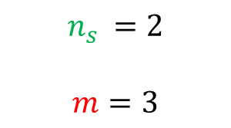
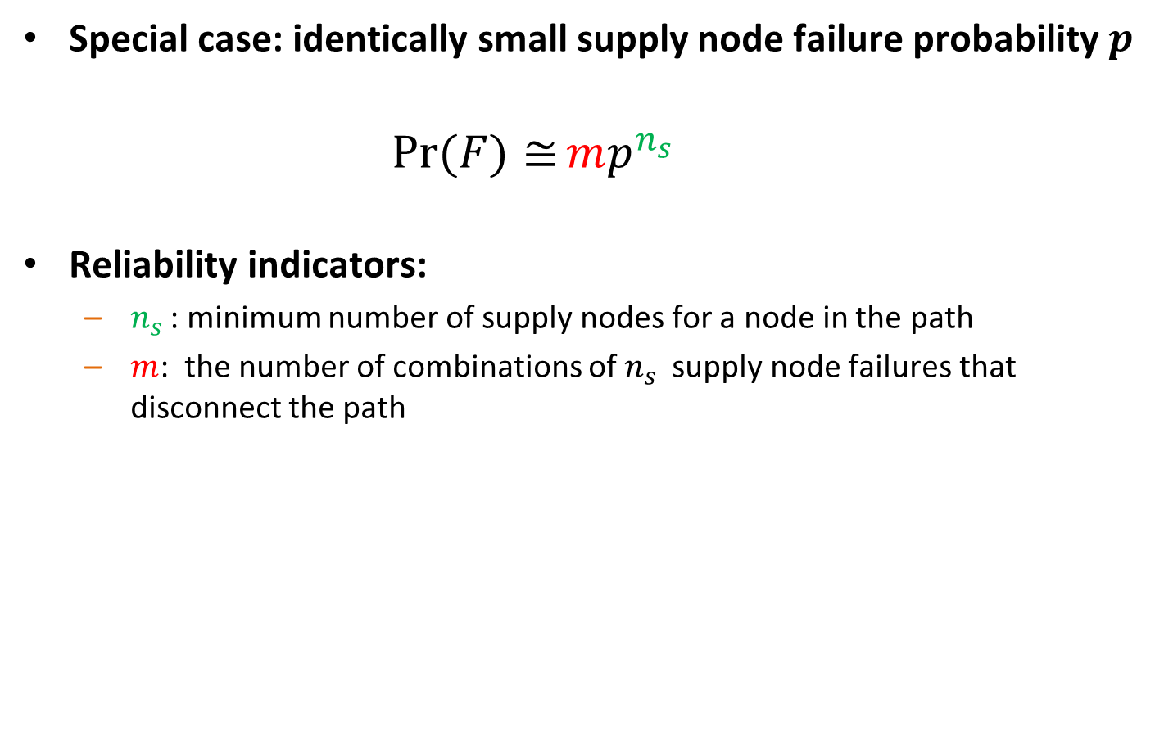
Evaluation of path failure probability
Special case: identically small supply node failure probability $p$
$Pr(F){≅}mp^{n_{s }}$
Reliability indicators:
$n_{s }$: minimum number of supply nodes for a node in the path
$m$: the number of combinations of $n_{s }$ supply node failures that disconnect the path
3
$$n_{s }=2$$
$$m=3$$

Slide 28
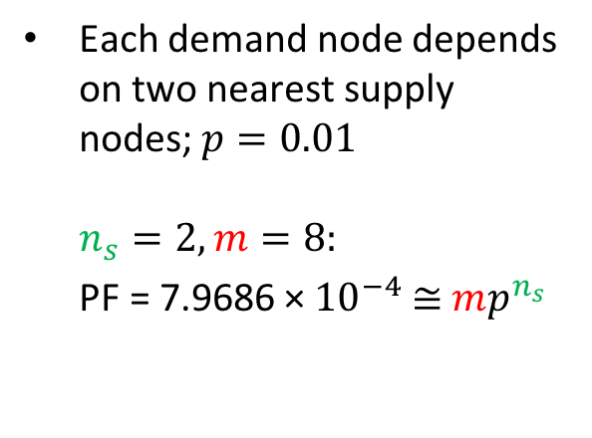
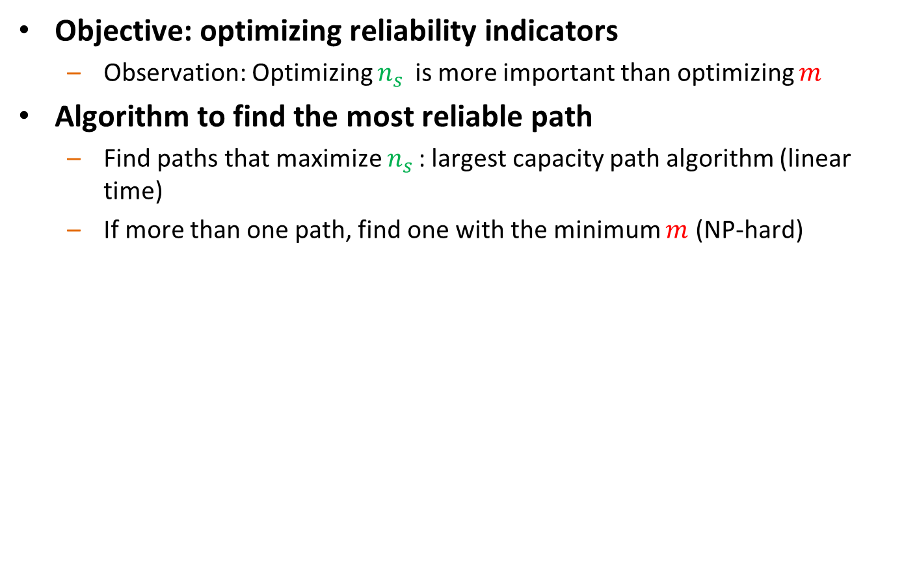
Finding the most reliable path (Small failure Prob)
Objective: optimizing reliability indicators
Observation: Optimizing $n_{s }$ is more important than optimizing $m$
Algorithm to find the most reliable path
Find paths that maximize $n_{s }$: largest capacity path algorithm (linear time)
If more than one path, find one with the minimum $m$ (NP-hard)
Each demand node depends on two nearest supply nodes; $p=0.01$ $n_{s}=2, m=8:$
PF = 7.9686 × ${10}^{−4}$ $≅$ $mp^{n_{s }}$
supply node demand node

Slide 29
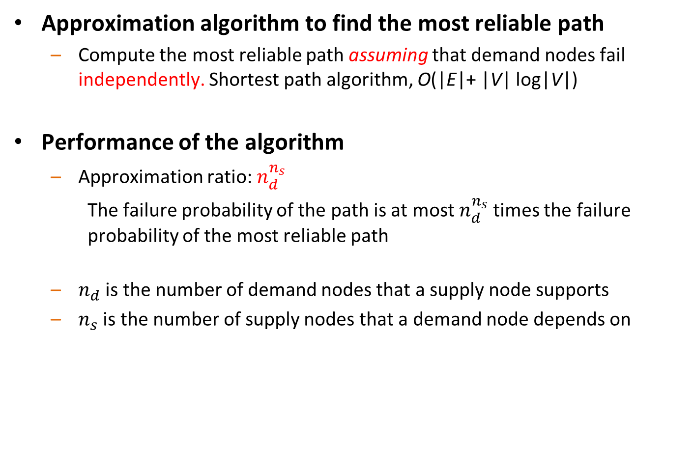
Finding the most reliable path (general case)
Approximation algorithm to find the most reliable path
Compute the most reliable path assuming that demand nodes fail independently. Shortest path algorithm, O(|E|+ |V| log|V|)
Performance of the algorithm
Approximation ratio: $n_{d}^{n_{s}}$
The failure probability of the path is at most$n_{d}^{n_{s}}$ times the failure probability of the most reliable path
$n_{d}$ is the number of demand nodes that a supply node supports
$n_{s}$ is the number of supply nodes that a demand node depends on

Slide 30
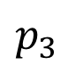
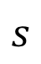
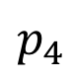
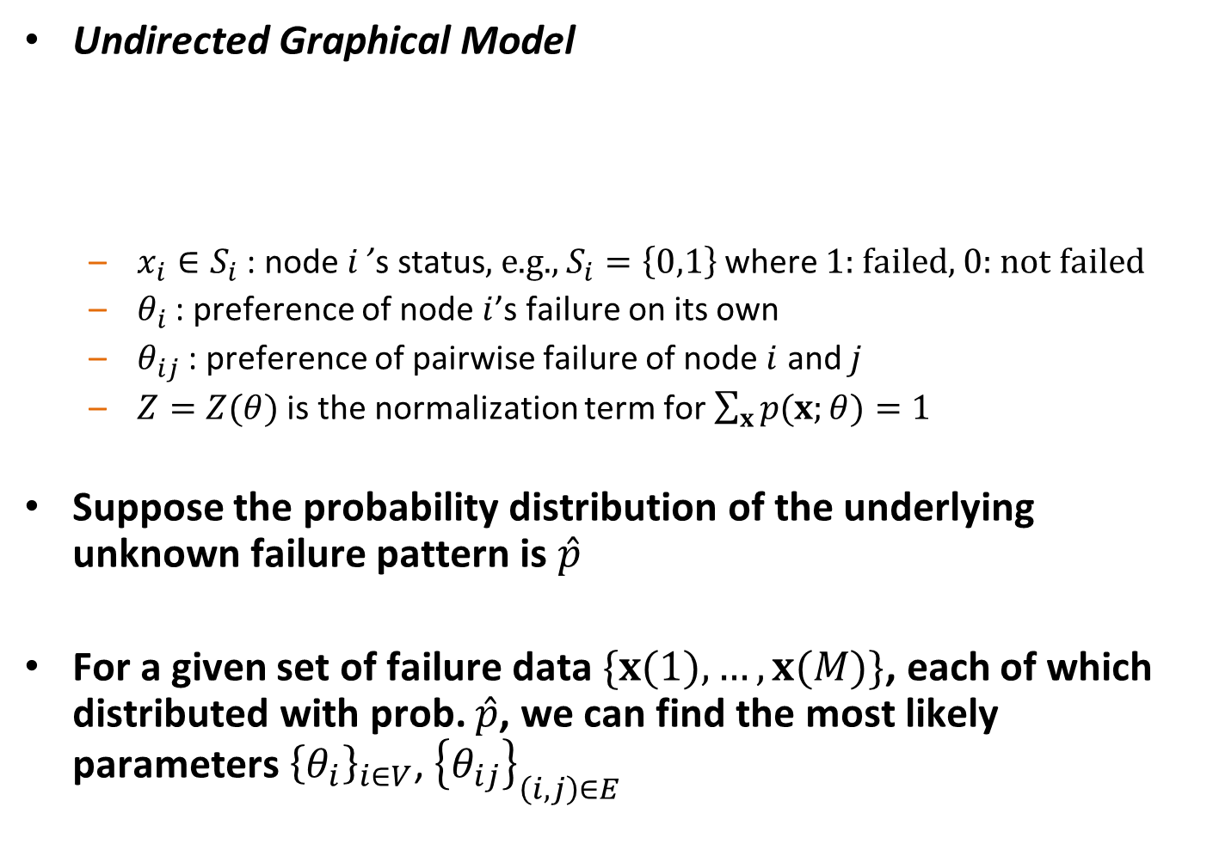
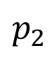
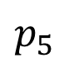
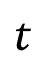
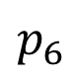
Diverse routing
Diverse routing improves reliability by using two or more paths
1: Evaluate the failure probability of two paths
2: Find the most reliable pair of paths between a pair of nodes
A
B
G₁
demand network
$$s$$
C
$$t$$
D
G₂
$$p_{1}$$
$$p_{2}$$
$$p_{3}$$
$$p_{4}$$
$$p_{5}$$
$$p_{6}$$
supply network
Notes:
Consider two interdependent networks, where nodes in one network provide supply to the other network. After removing nodes in one network, some nodes in the other network may lose its supply nodes and fail, and the other network may become disconnected.
To study the impact of node failures in one network on the other network, we focus on “network connectivity” as a metric for network functionality. Given two interdependent networks, we study the minimum number of node removals in one network to disconnect the other network.
Moreover, we study the network design problem to assign the interdependence between two networks, to maximize the number of node failures that both networks can resist.
To simplify the presentation, we consider a demand network and a supply network, and study the impact of node removals in the supply network on the demand network.

Slide 31

Computing the failure probability of two paths
Small failure probability
$\operatorname{Pr}{(F)}≅cp^{d+1}$
Reliability indicators:
$d$-failure resilient: at least one path survives after any $d$ supply node failures
$c$: the number of combinations of $d+1$supply node failures that disconnect both paths

Slide 32


Finding a pair of reliable paths (Small P case)
Objective: optimizing reliability indicators
Observation: optimizing $d$ is more important than optimizing $c$
Algorithm to compute a reliable pair of paths
Integer program
Smaller cuts have larger weights. Minimize the total weights of cuts.
Each demand node depends on two nearest supply nodes; $p=0.01$.
Seattle-Miami: $d=1$
$$PF=1.0388×{10}^{−4}$$
Note that the most reliable path (previous example) is not in the pair
supply node demand node

Slide 33

Finding a pair of reliable paths (general case)
A heuristic to compute a reliable pair of paths
1. Assume independent demand node failures.
2. Find one path with the minimum failure probability.
3. Find one augmenting path with the minimum failure probability.
$$p$$ | optimal | heuristic
0.01 | 1.0388$×{10}^{−4}$ | 1.0773$×{10}^{−4}$
The most reliable pair of paths
A pair of paths computed by the heuristic

Slide 34
Summary
Layered graph model for interdependent networks (supply and demand networks)
Captures many realistic scenarios: e.g., power-comms, etc.
Developed methods to evaluate reliability of network and paths
Developed methods to find the most reliable path, and pairs of paths
Improve reliability through diverse routing

Slide 35
Outline
Introduction
Theory: modeling interdependent networks
Random geometric graph
Percolation analysis
Random and geographical failures
Arbitrary graph
Network connectivity under failures
Robust routing under failures
Applications of interdependent networks
Interdependent power grid and communication network
Distributed cloud network
Future work

Slide 36
Power grid frequency control
Classic:
Frequency regulation (to recover nominal frequency) and economic dispatch both require communication
Recent advance:
Distributed control (communication between neighbors)
Frequency regulation by adjusting power generation using local frequency deviation (smaller frequency -> more generation)
Economic dispatch using the common frequency deviation information
Our contribution:
Achieving both frequency regulation and economic dispatch using no/limited communication
Characterizing the importance of communication, dependent on power grid topology and physical properties
Breaking the hierarchy: Distributed control & economic optimality in microgrids (Dörfler, Simpson-Porco, Bullo 2014)
Optimal load-side control for frequency regulation in smart grids (Mallada, Zhao, Low 2014)

Slide 37






Model
Economic dispatch & Frequency regulation
Minimize cost of adjustable power
Power balance
Optimal solution (ignoring power line thermal limits and generation constraints)
Network dynamics
Swing equation
Power line
Control
Control the adjustable power $u$ for economic dispatch and frequency recovery, using power grid measurement information and communication
$$min\sum_{i}{\frac{1}{2}a_{i}u_{i}^{2}}$$
$$\sum_{i}{\left(p_{i}+u_{i}−\sum_{j:\left(i,j\right)∈E}{f_{ij}}\right)=0}$$
supply = demand
$$a_{i}u_{i}=a_{j}u_{j}$$
$$M_{i}{\dot{ω}}_{i}\left(t\right)=−D_{i}ω_{i}\left(t\right)+p_{i}\left(t\right)+u_{i}\left(t\right)−\sum_{j:\left(i,j\right)∈E}{f_{ij}\left(t\right)}$$
$${\dot{f}}_{ij}\left(t\right)=B_{ij}(ω_{i}\left(t\right)−ω_{j}\left(t\right))$$

Slide 38



Integral control policy
Adjust the controllable power by local frequency measurement
Intuition:
The phase angel difference before and after the disturbance provides reference to the adjustable power
Theorem:
For $k_{i} = h/a_{i}$, the cost under the integral control is at most $4{\left(Δ p\right)}^{2} n h / (b λ_{2})$ more than the optimal cost, where $Δ p$is the power disturbance at a bus, $n$ is the number of nodes, $λ_{2}$is the algebraic connectivity of $G$, $h > 0$, and $b$ is the minimum power line susceptance.
$${\dot{u}}_{i}\left(t\right)=−k_{i}ω_{i}\left(t\right)$$
$ω_{i}$: Frequency deviation (from nominal frequency)
$$u_{i}\left(t\right)=−k_{i}(θ_{i}\left(t\right)−θ_{i}\left(0\right))$$

Slide 39


Performance of the integral controller
The integral controller achieves near optimal economic dispatch, if either of the following holds
Power line susceptance $b$ is large
Controller gain $h$ is small
Example:
8
9
7
10
1
2
5 units demand increase
5
6
3
4

Slide 40
Tradeoff: convergence time and cost
A small controller gain is needed to achieve near-optimal economic dispatch
The convergence time increases as the cost decreases
Example: optimal cost 23.27
convergence time (s) | 100 | 200 | 300 | 500 | 1000
cost | 39.11 | 31.81 | 28.89 | 26.30 | 24.41

Slide 41

Delayed control
Adjust power generations after a timeout period
Intuition
The frequencies at different generators are nearly synchronized under primary droop control, after a timeout period
The common frequency deviation serve as a reference to adjust power generations
${\dot{u}}_{i}\left(t\right)=−k_{i}ω_{i}\left(t\right)$, for $t ≥T$
${\dot{u}}_{i}\left(t\right)=0$, for $t < T$

Slide 42

Delayed control
Faster convergence compared with the original integral control
Benefit: a larger controller gain to achieve the same cost
Cost: no control over a timeout period
original integral control, cost = 39.11
delayed control, cost = 27.57 (T = 30s)
Over 30% cost reduction at the cost of 30s longer convergence time.
Compare: 350s convergence time for the original control to achieve the same cost.

Slide 43



Arbitrary convex cost
cubic cost
Virtual price $v$
Notations:
Marginal cost at generator $i$ when the generation is $u_{i}$: $g_{i}(u_{i})$
Inverse function $g_{i}^{−1}(v_{i}\left(t\right))$computes the generation amount to have the marginal cost $v_{i}\left(t\right)$
Intuition:
The virtual prices $v_{i}\left(t\right)$ are almost identical at all generators
The marginal costs are almost identical
${\dot{v}}_{i}\left(t\right)=−k_{i}ω_{i}\left(t\right)$,
$u_{i}\left(t\right)=g_{i}^{−1}(v_{i}\left(t\right))$.

Slide 44


Generator capacity constraint
Power generation capacity constraints
Suppose the adjustable power generation should be within $[c_{1},c_{2}]$
The control is modified to
${\dot{v}}_{i}\left(t\right)=−k_{i}ω_{i}\left(t\right)$,
$u_{i}\left(t\right)=max(c_{1},\min{(c_{2},} g_{i}^{−1}\left(v_{i}\left(t\right)\right)) )$.

Slide 45





Control policy using communication
Communication exchanges marginal costs
$$i$$
$$j$$
$$l$$
$$k$$
$V^{∗}$: boundary nodes in a component of communication network (e.g., $i,j,k,l$)

Slide 46

Role of communication
Exchange marginal cost information
Reduce convergence time by allowing larger controller gains
Example:
Full communication: convergence time: 200s; cost: 23.27
No communication: convergence time: 1500s; cost: 23.56
Full communication
No communication

Slide 47

Importance of individual communication link
The failures of communication links have less severe impact if the corresponding power line has large susceptance
Cost: 26.17
Cost: 34.36

Slide 48
Summary
A decentralized integral controller that achieves both frequency recovery and economic dispatch
Near-optimal economic dispatch if the line susceptance are large or the controller gains are small
General convex cost
Generator capacity constraint
Delayed control
Communication reduces the convergence time

Slide 49
Outline
Introduction
Theory: modeling interdependent networks
Random geometric graph
Percolation analysis
Random and geographical failures
Arbitrary graph
Network connectivity under failures
Robust routing under failures
Applications of interdependent networks
Interdependent power grid and communication network
Distributed computing network
Future work

Slide 50




Distributed computing networks
A network supporting both communication and computation
Service function chaining
Video streaming
Cloud/fog computing
Real time communication
Choose a server to serve the content

Slide 51






Model
Graph $G(V,E)$ represents a computing network
Flow is processed at computation nodes $V_{c}⊆V$
Computation constraints at nodes $V_{c}$
Communication constraints at links $E$
$$u$$
$$d$$
Computation node $V_{c}=\{u\}$
Communication links
$$E=\{\left(s,u\right),\left(u,d\right),\left(s,v\right),(v,d)\}$$
$$s$$
$$v$$

Slide 52




Network flow in computing networks
A network flow
from source to destination
needs to be processed at a computation node
Computing the maximum flow from source to destination
Linear programming (polynomial time)
$$u$$
$$s$$
$$d$$
$$v$$

Slide 53














Robustness metric – Cut
Communication cut
Computation cut
Joint communication and computation cut
$$s$$
$$u$$
$$v$$
$$d$$
10 1 10 1 10 cut = 10, flow = 2
$$s$$
$$u$$
$$v$$
$$d$$
1 10 1 10 1 cut = 20, flow = 1
1
1
1
$$u$$
$$v$$
5
5
$$s$$
$$d$$
cut = 1 + 1 + 1 = 3
flow = 1 + 2 = 3
5
$$u$$
$$v$$
5
1
5
1

Slide 54






Max flow min cut
Min joint cut is at most twice the max flow
Proof using layered graph
Example: Min cut can be twice as large as the max flow
Directed graph
Undirected graph
2
2
$$v$$
$$v$$
2
2
2
2
2
$$s$$
$$t$$
$$s$$
$$t$$
Max flow = 1
Min cut = 2
Max flow = 1
Min cut = 2
Max flow = min cut, for classical flow network [Ford & Fulkerson, 1956]

Slide 55
Summary
Models for interdependent networks
Interdependent RGGs
Layered graph model
Analysis of interdependent networks robustness and cascading failures
Increase the resilience to node failure
Robust routing
Applications
Power grid monitoring and control using communication
Distributed computing network, data center networks

Slide 56
Summary
Modeling
Control
Analysis
Power grid frequency control [5]
Percolation [1,2]
Connectivity [3]
Interdependent RGGs [1,2]
Traffic control in distributed computing networks [6]
Layered graph [3,4]
Routing [4]
[1] Robustness of interdependent random geometric networks, Allerton, TNSE.
[2] Robustness of interdependent random geometric networks under inhomogeneous failures, WiOpt.
[3] Connectivity in interdependent networks, TON.
[4] Robust routing in interdependent networks, INFOCOM.
[5] Joint frequency regulation and economic dispatch using limited communication.
[6] Optimal control of distributed computing networks with mixed-cast traffic flows, INFOCOM.
Notes:
To facilitate this goal, this project has three inter-dependent thrusts, Modeling, analysis, and control…
Mathematical tools:
Modeling & Analysis -> Graph theory, Random graphs, Probability theory, Percolation theory, Markov model, …
Modeling & Control -> Control theory, Game theory, Network survivability, Distribution algorithms, Combinatorial optimization, …
How to defend against large scale (WMD) attacks on interdependent networks
Approach: Divide and conquer strategy…

Slide 57
Future work
Design
Operation
& control
Reinforcement
Deployment
Understand the vulnerabilities of critical infrastructures and enhance their robustness
Improve the efficiency and performance of large-scale computing though tightly coupled compute, storage, and networks; power grid with renewable energies
Notes:
Chen wenguang
Supercomputing
Wu JianPing
Cui yong
Li yong, 人流控制
Sigeminaxiang习总四个面向
Liu yunxin 张亚勤
Low carb
6G
Dianci kongjian yitihua. Tongxin sensor,
Lu mingquan, no GPS comm
Multi agent, tongxin dingwei daohang, daji
Medical engineering, care
Micro, wulidianzi. Optics
AI chip, optics computing
AD, DA, THz
Computing
0-》1
低碳，碳中和

Slide 58
Backup slides

Slide 59
Related work
Flow-based network models (network level interdependence)
Power flow in power grids, failure dynamics [Parandehgheibi, et al., 2014, 2015]
Communication failure in distributed control (economic dispatch in power grid) [Parandehgheibi, et al., 2016]
Load re-distribution after failures, sandpile [Brummitt, et al., 2012; Yagan, et al., 2016]
Others (without network structures in the analysis)
Empirical (history data after hurricanes)
Agent based approach (assuming agent’s behaviors under various environment)
System dynamics based approach (modeling system-level behavior by differential equations)
Input-output model (economics, correlation matrix, linear relationship; can be generalized to non-linear relationship)

Slide 60
Data-driven localization and estimation of disturbance in the interconnected power system

Slide 61
Power line susceptance
Z=R+iX. Z: impedance. R: resistance. X: reactance
Y=G+iB. Y: admittance. G: conductance. B: susceptance
Y = 1/Z
Conductive line: R=0, G=0.
Resistive line: X=0, B=0.

Slide 62

Power grid disturbance estimation
Disturbance: load increase
Frequency response after the disturbance
Observations:
Frequency at generators (by PMUs)
Goals:
Disturbance localization
Disturbance magnitude estimation
load increase
frequency measurements

Slide 63
Problem overview
Based on power grid transient state measurements (frequency deviations), estimate the disturbance location and magnitude
Impact: The estimation can be used for timely control (e.g., load shedding) to mitigate the disturbance or failure
Methodology: Model-free approach, machine learning
Regression: linear regression for disturbance magnitude estimation
Classification: logistic regression for disturbance localization

Slide 64


Feature vector
Frequency deviations after the disturbance imply the disturbance magnitude
The frequency measurements are noisy ($σ=5$mHz)

Slide 65

Conclusion
Estimate system disturbance/failure using transient state measurement
Machine-learning approach to estimate power grid disturbance location and magnitude
Logistic regression for localization
Linear regression for magnitude estimation
Impacts of $W_{s}, W_{a},$ regularization, missing information (communication failure)
Impacts
Much more accurate than equation-based approach
Timely control to mitigate disturbance/failure

Slide 66
Optimal control of distributed computing networks with mixed-cast traffic flows

Slide 67
Background – service function chain
Service function chain
Video streaming: firewall, transcoding, decoding
source
firewall
encoding
transcoding
destination
decoding
1
2
3
4
VF
VF
VF
VF
VF
VF
VF

Slide 68












Model
Network model
Computation/forwarding nodes (computation capacity $μ_{i}$)
Communication links (transmission capacity $μ_{ij}$)
$$μ_{u}=1$$
$$μ_{su}=1$$
$$u$$
$$μ_{s}=0$$
$$s$$
$$d$$
$$μ_{d}=0$$
$$v$$
$$μ_{v}=0$$
A flow from $s$ to $d$ has to go through $u$ to be processed.

Slide 69


Numerical result
Lower delay under UCNC, compared with backpressure algorithm
Commodity 1: 1 -> 11
Commodity 2: 4 -> 7
Computation nodes: 3, 8

Slide 70

Numerical result
Mixed-cast simulation
12 unicast and 6 multicast flows
3 different service function chains
Blue: treating a multicast flow as multiple unicast flows
Red: mixed-cast flow under UCNC (throughput optimal)

Slide 71
Conclusion
Universal Computing Network Control (UCNC)
Jointly optimize packet routing and processing
First throughput-optimal algorithm for multicast service function chain traffic
Significantly lower delay compared with backpressure algorithm

